Slide 1
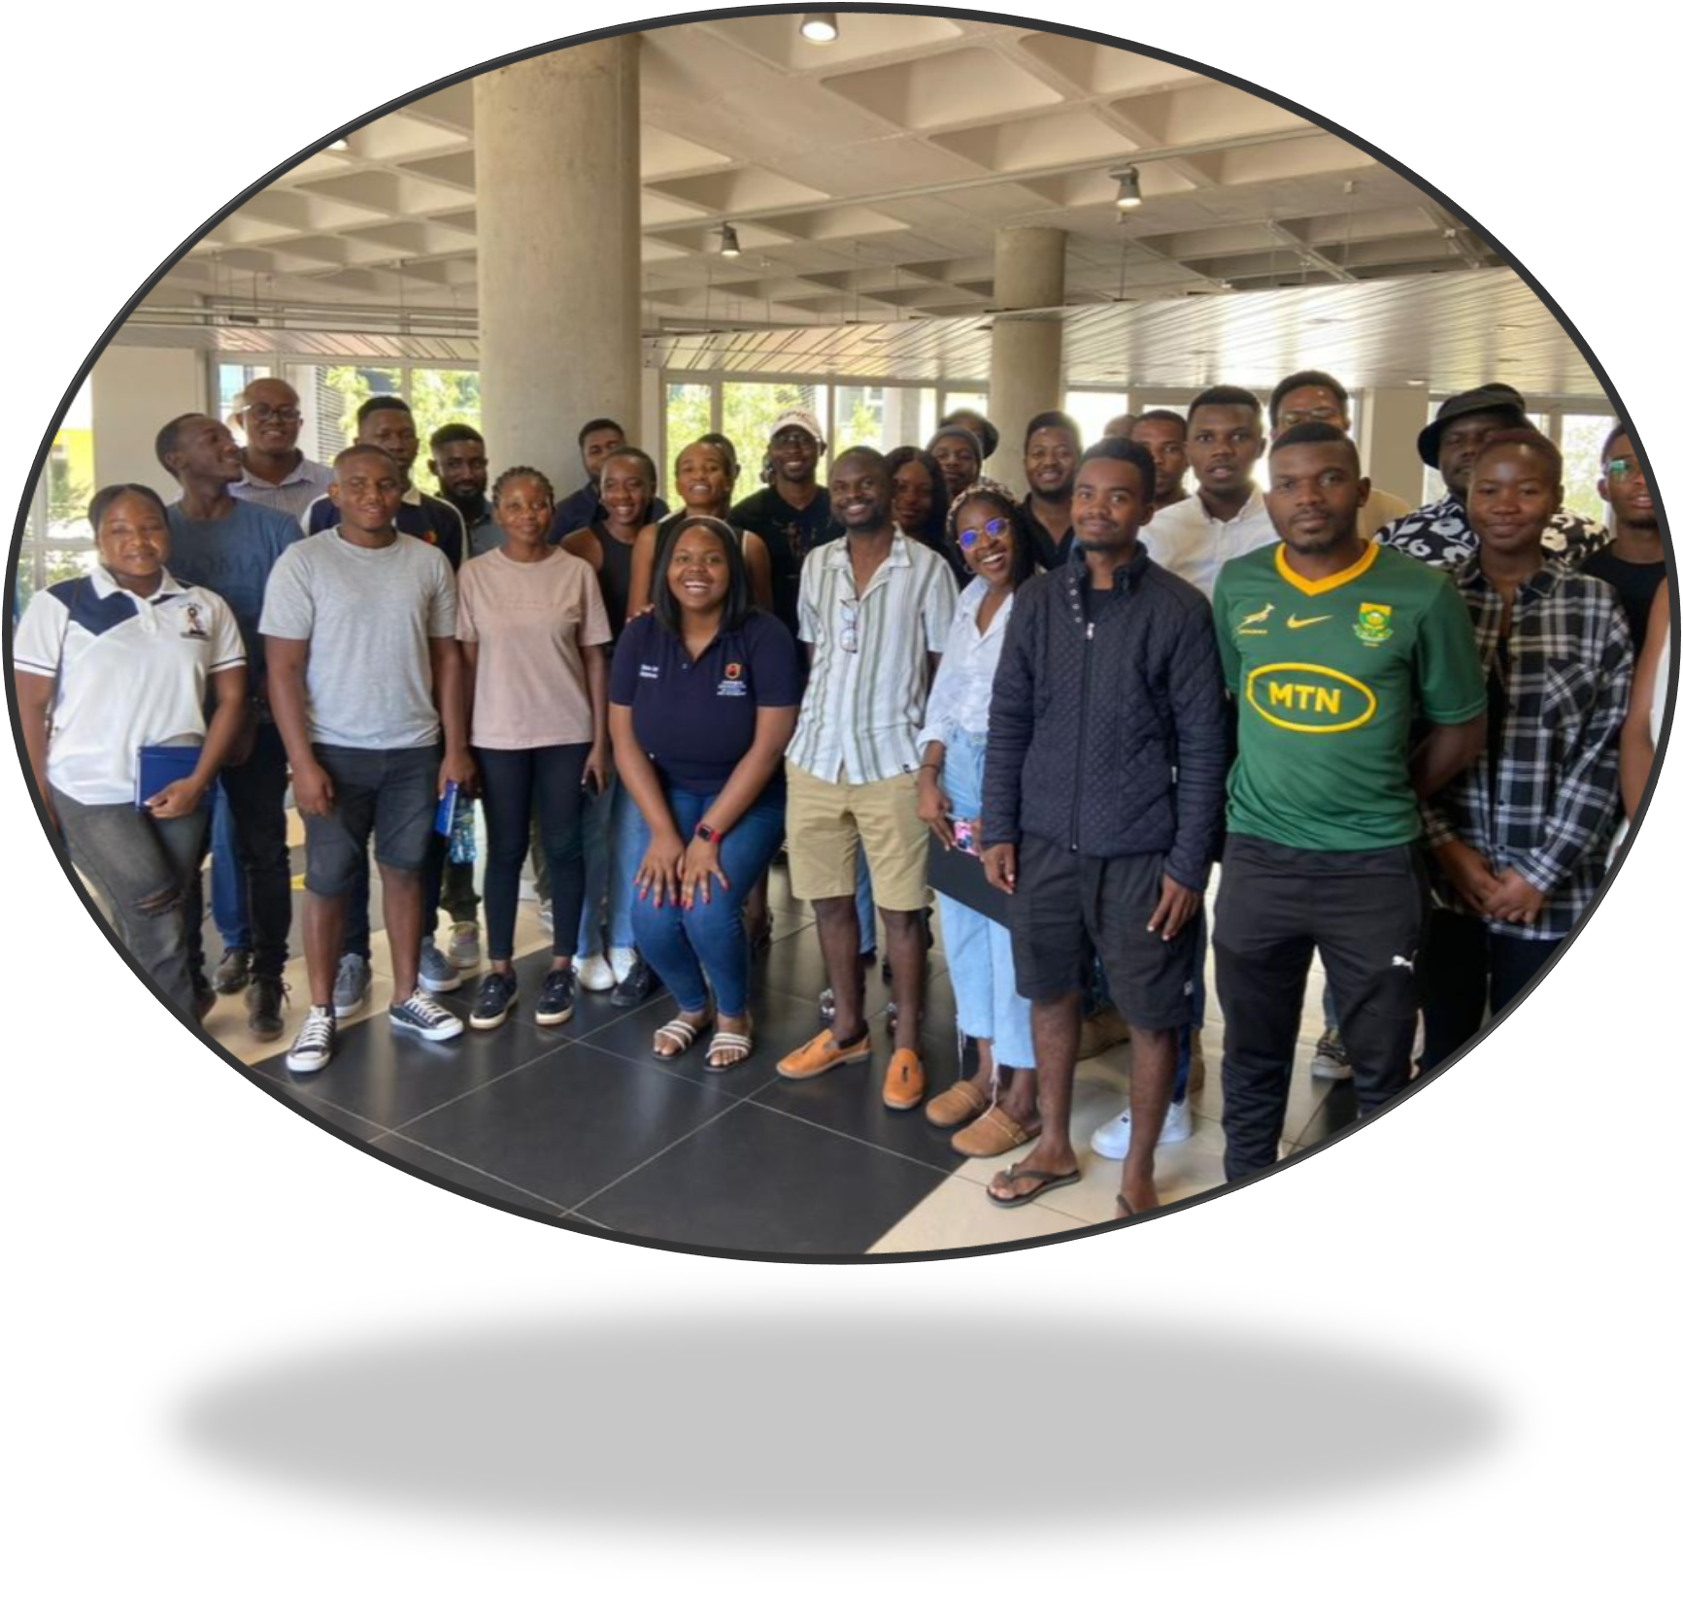
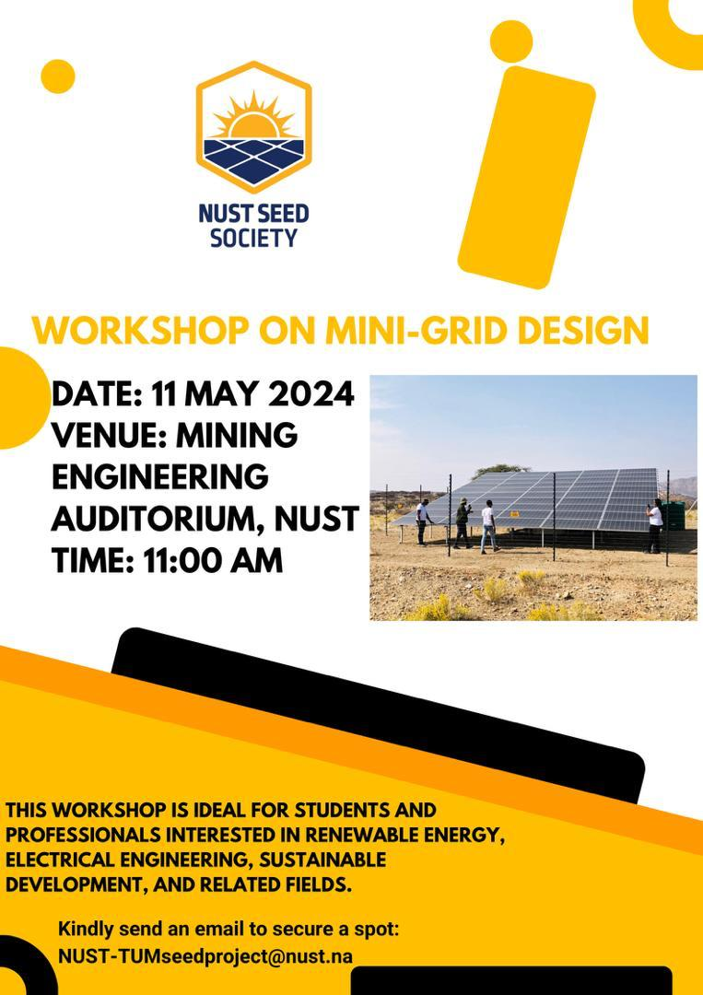
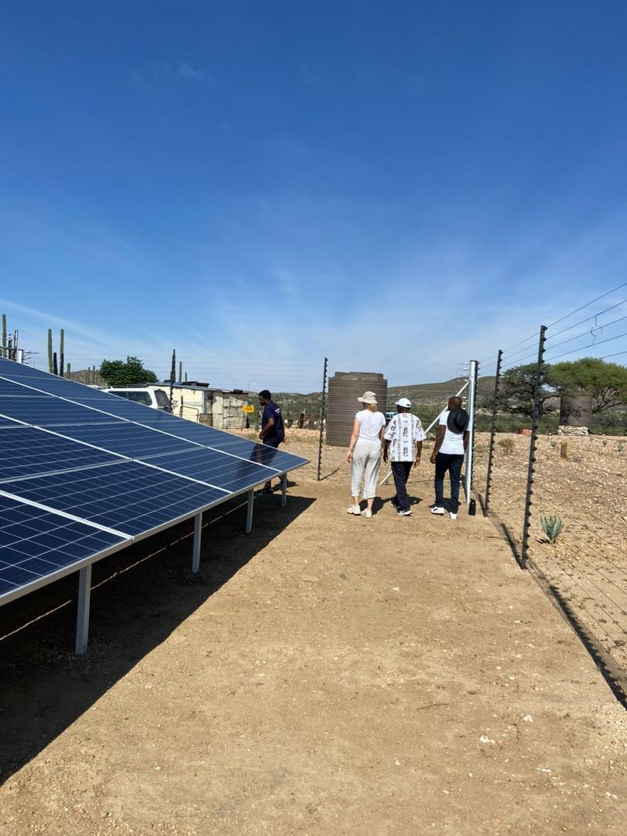
NUST SEED SOCIETY
The NUST SEED society aims to create an intersection of sustainable energies and entrepreneurship and conduct research to contribute to the 2030 Agenda for Sustainable Development Goals as well as create awareness on the benefits of sustainably using renewable energy and establishing entrepreneurial activities for social development
Activities completed:
Registration of the Society on campus
Registration of Members
Drafting the Constitution of the society
Creation of Social Media Pages
Official Launch of the Society on Campus
Academic Exchange Panel Discussion
Workshop on Mini-Grid design
Activities planned:
Youth Engagement Event
Community engagement sessions
Day visit to the living lab
Visit to High schools to raise awareness on Sustainable Energy and Entrepreneurship
WORKSHOP ON MINI-GRID DESIGN
Key Areas of focus:
Renewable energy potential and projects in Namibia
Electricity generation, transmission, and distribution challenges
Green hydrogen initiatives and entrepreneurial opportunities
Energy efficiency and conservation
Rural electrification and access
Careers in the energy and electricity sectors
Case study: NUST-SEED Living Lab at Farm (!Kharoxas)
SOCIETY MEMBERS
Connect with us on Social Media:
@nustseedsociety
@NUST-SEED Center

